Slide 1
Seed App
Peer-to-peer file sharing system
Each instance acts as both client and server
Multiple file downloads

Slide 2
Supports:
File discovery peers
Seeder validation
Chunked downloads
Download status monitoring

Slide 3
THREADING MODEL
Main thread → Menu loop, user input.
Server thread → Runs accept_clients().
Spawns client threads for each incoming connection.
Tick thread → Periodically refreshes downloads (every 2s).
Worker threads → Spawned by download_manager for each seeder.
Each worker connects to a seeder port and fetches chunks.

Slide 4
SERVER VS CLIENT SOCKET MODEL
Each app instance reserves one port (9000–9004)
On that port:
It creates one listening socket (used only for accept() calls)
When a peer connects:
accept() returns a new client socket
A new thread is spawned to handle that client socket.
Outgoing connections
creates client sockets to connect to other peers’ server ports.
Each client socket is independent of the listening socket.

Slide 5
SERVER VS CLIENT SOCKET MODEL
9001
9000
client
socket
9002
server
socket
client
socket
9003
client
socket
client
socket
One server listening socket per port
Multiple client sockets (one per connection), each handled in its own thread.
9004

Slide 6
PEER & PORT DISCOVERY
Port Manager scans a fixed range (9000–9004).
First free port → reserved for the server socket.
To discover peers:
The app attempts to connect to other ports in the range.
If connection succeeds, it queries the peer for file lists.

Slide 7

MENU OPTIONS
Option 1 - Download File
Discover files from peers
Select file by ID
Resolve live seeders
Start download
Option 2 - Download Status
Show progress
Refresh every seconds
Exit on key press
Option 3 - Exit
Stop server
Join threads
Release port

Slide 8
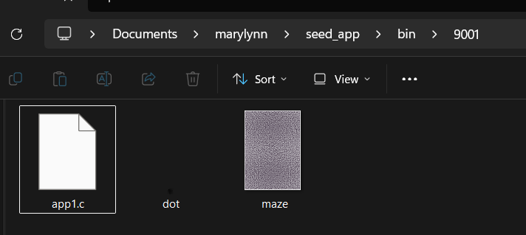
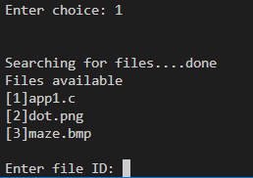
FILE DISCOVERY
Client connects to each peer
User sends choice 1 → list files
Parses filename\t<size> format
Deduplicates by file.key() (name+size)
Sort alphabetically
Builds network_file list

Slide 9
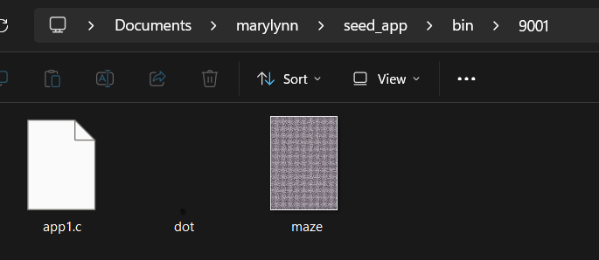
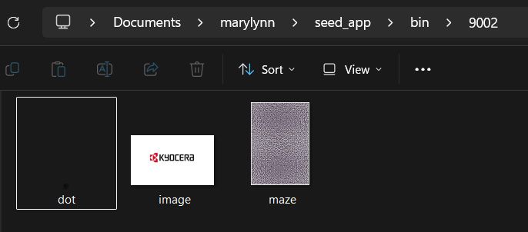
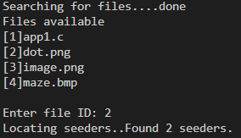
SEEDER RESOLVE
Uses AppSeederResolver
Calls SeederProbe::probe():
Check connected ports
Verifies file presence
Return reachable seeders

Slide 10

DOWNLOADS
DOWNLOAD MANAGER
WORKER THREAD (SEEDER A)
Download Manager spawns one worker thread per seeder.
Each worker independently:
Claims chunks
Fetches them
Writes them
When all chunks are done:
Last worker renames .part → final file
Job marked Completed
claim_chunk → download → write → mark done
WORKER THREAD (SEEDER B)
claim_chunk → download → write → mark done
WORKER THREAD (SEEDER B)
claim_chunk → download → write → mark done

Slide 11
DOWNLOADING MODEL
File split into chunks (default 32 bytes).
Each worker thread:
Connects to a seeder via client socket repeatedly.
Calls claim_chunk_static(job):
Iterates over all chunks.
Atomically marks the first available chunk (state = 0 → 1).
Returns that chunk index.
Requests chunks (Downloader::fetch_chunk_on_connection).
Downloads the chunk from its seeder.
Writes them into .part file.
Marks chunk as completed (state = 2).

Slide 12
WORKERS MODEL
(Work‑stealing / atomic claim scheduler)
Workers race to claim the next available chunk.
The first thread that successfully flips a chunk’s state gets it.
Multiple workers can download different chunks simultaneously.
Any worker can claim any free chunk, no strict ordering.
If a worker fails, its chunk is reset to 0 (unclaimed) so another worker can retry.
Dynamic load balancing: Faster seeders naturally complete more chunks because they claim more often.

Slide 13
How to make sure that while downloading we are connected to ports that have just connected recently?

Slide 14
TICK THREAD LOGIC
Runs every 2 seconds
Refreshes stalled downloads
Uses resolver (seeder probe) to find new seeders
Spawns new workers if needed especially for cases of those disconnected seeders while downloading

Slide 15
DOWNLOAD COMPLETION
Workers exit when done
Final worker renames .part → final file
Updates status:
Idle
Downloading
Completed
Failed
Stalled

Slide 16
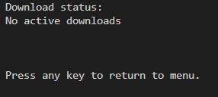
DOWNLOAD STATUS
IDLE
No active download is happening.
Either waiting for a job to start or no jobs exist.
Rarely used in your flow since jobs usually start directly as Downloading.

Slide 17
DOWNLOAD STATUS
Downloading
Active worker threads are fetching chunks from seeders.
Chunks are being claimed, downloaded, and written into the .part file.
This is the “normal running” state.

Slide 18
DOWNLOAD STATUS
Completed
All chunks have been successfully downloaded.
The .part file is renamed to the final file.
Job marked as finished, no more worker threads running.

Slide 19
DOWNLOAD STATUS
Stalled
Download progress has stopped (no seeders available, workers exited without completing).
Not failed yet — system will try to recover by refreshing seeders in the tick thread.
Acts as a “pause” state until new seeders are found.

Slide 20
DOWNLOAD STATUS
Stalled
Download progress has stopped (no seeders available, workers exited without completing).
Not failed yet — system will try to recover by refreshing seeders in the tick thread.
Acts as a “pause” state until new seeders are found.

Slide 21
DOWNLOAD STATUS
Failed
The source file on the seeder was deleted or moved.
The output file cannot be created or written to (disk full, permission denied).
Protocol violation (wrong chunk size, invalid offset).

Slide 22
CLEAN UP
On exit:
Cancels jobs
Joins threads
Releases port

Slide 23
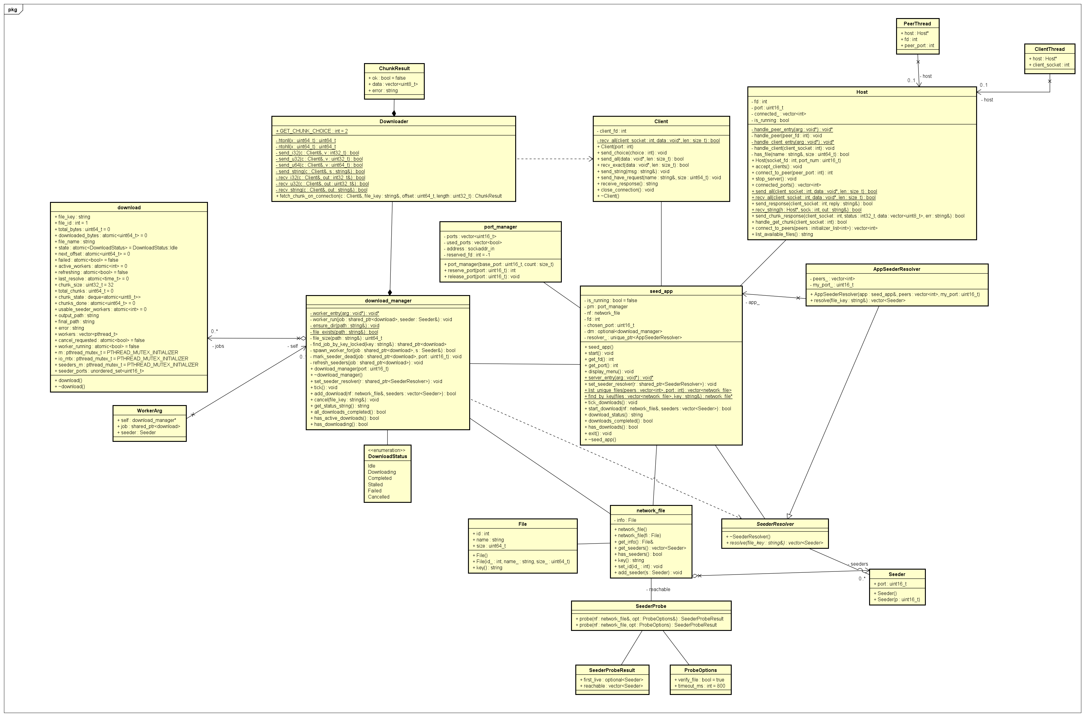
CLASS DIAGRAM

Slide 24
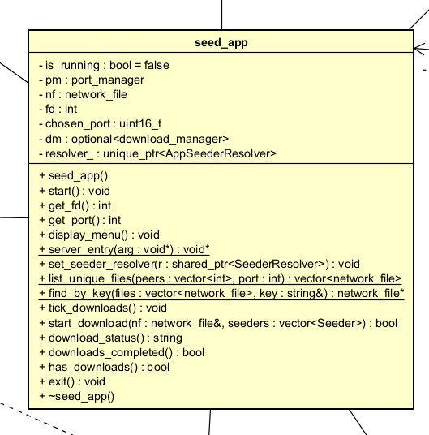
User Starts the App
Notes:
When the user starts the application, the seed_app is initialized. This is the entry point of the system. Its job is to set up networking, show the menu, and coordinate downloads. seed_app calls the port_manager to reserve a free port (between 9000–9005). This port becomes the peer’s identity in the network.

Slide 25
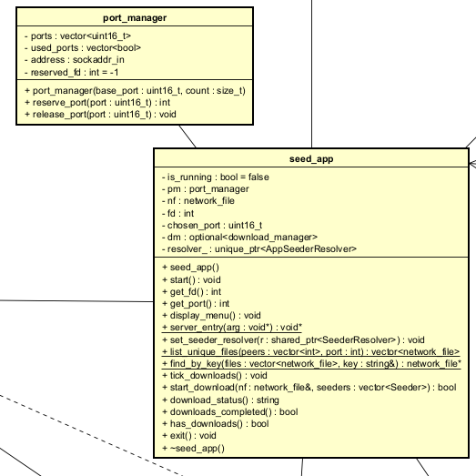
Port Manager
Notes:
The port_manager keeps track of which ports are available, reserved, or released. It ensures no two peers collide on the same port.
reserve_port() binds a socket to a port. release_port() frees it when the app exits.

Slide 26
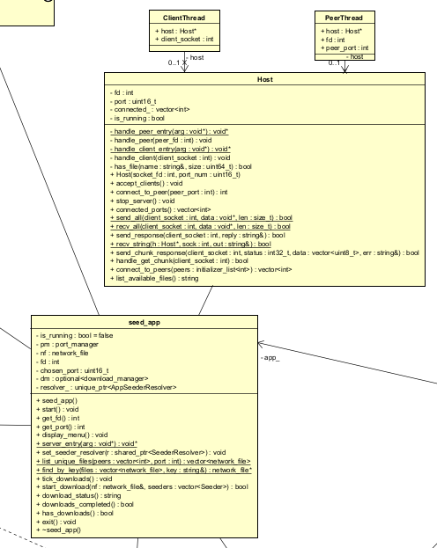
Host Server Starts
Notes:
“Once a port is reserved, the app spins up a Host server. This is the server side of the peer. It listens for incoming connections and serves chunks to other peers.

Slide 27
Menu Interaction
Notes:
“The user sees a menu with options: download a file, check status, or exit. Choosing download triggers peer discovery.
seed_app::display_menu() shows options.
Input is read and passed to the appropriate function.

Slide 28
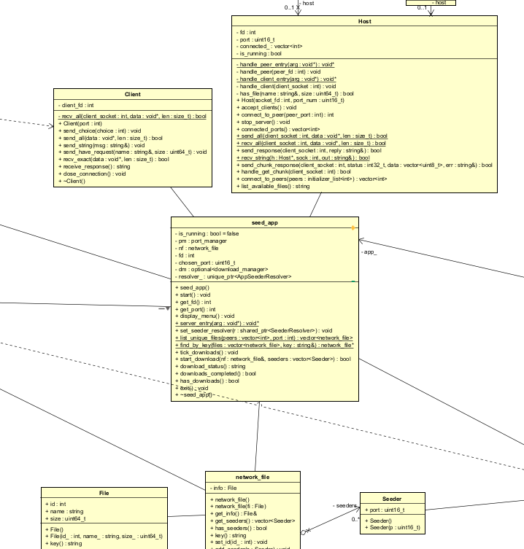
Discovering Files
Notes:
To discover files, the app queries other peers. It uses the Client class to connect to each peer’s Host and request their file list. Client::send_choice(1) asks for available files.
Host::list_available_files() responds with filenames and sizes.
seed_app::list_unique_files() parses replies, removes duplicates, and wraps each file in a network_file object.

Slide 29
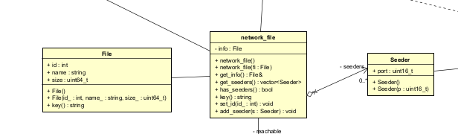
Network File
Notes:
A network_file represents a candidate file in the network. It contains metadata (File) and a list of seeders that host it.
network_file::get_info() returns file details.
network_file::add_seeder() adds peers that have the file.

Slide 30
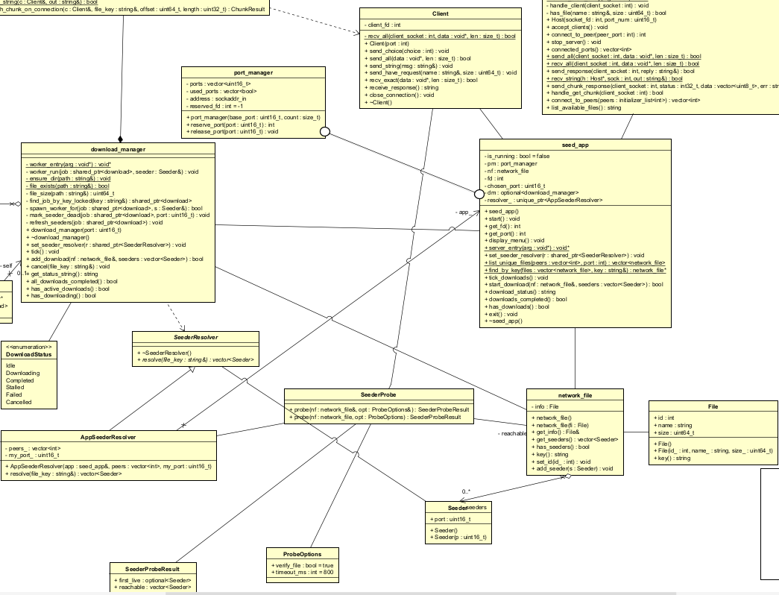
Resolving Seeders
Notes:
Once the user selects a file, the app needs to check which seeders are actually reachable. That’s where the AppSeederResolver and SeederProbe come in.
AppSeederResolver::resolve() calls SeederProbe::probe().
SeederProbe connects to each candidate seeder using Client, sends a ‘have file’ request, and validates the reply.
Only reachable seeders are returned.

Slide 31
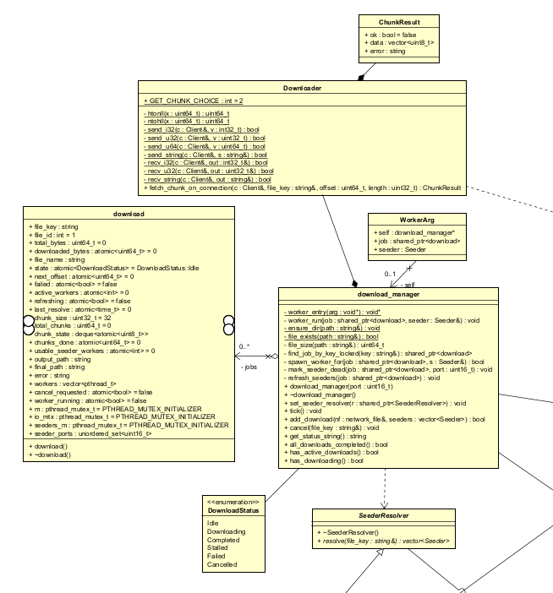
Download Manager Creates a Job
Notes:
With live seeders identified, the download_manager creates a new download job. It pre‑sizes a .part file, initializes chunk states, and spawns worker threads for each seeder.
download_manager::add_download() sets up the job.
download stores file key, chunk states, progress counters, and error messages.
spawn_worker_for() creates threads to fetch chunks.

Slide 32
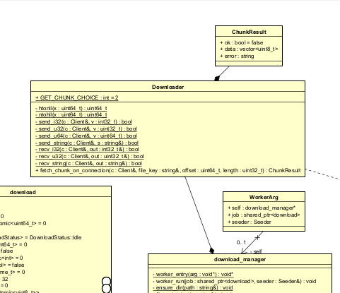
Downloader Fetches Chunks
Notes:
Each worker thread uses the Downloader class to request chunks from a seeder. The downloader sends the file key, offset, and length, then receives the bytes.
Downloader::fetch_chunk_on_connection() implements the chunk protocol.
Returns a ChunkResult with success flag, data, or error.

Slide 33

ChunkResult
Notes:
Every chunk request produces a ChunkResult. It tells us whether the chunk was successfully fetched, how many bytes were received, and if there was an error.
ChunkResult.ok indicates success.
ChunkResult.error explains failures.

Slide 34
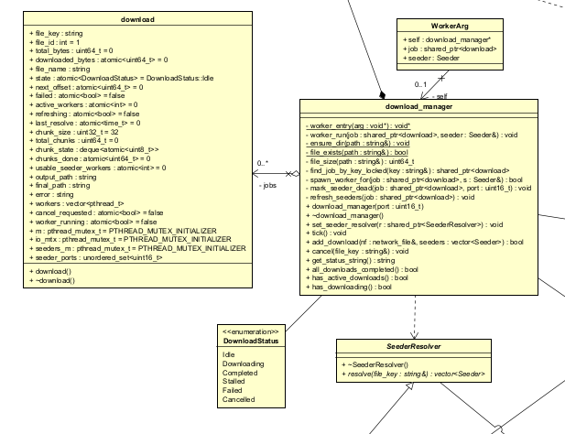
Error Handling
Notes:
“If a seeder fails, the worker marks it dead and calls refresh_seeders() to try new ones. If no seeders remain, the job stalls. If the file can’t be written, the job fails.
download_manager::tick() periodically refreshes seeders.

Slide 35
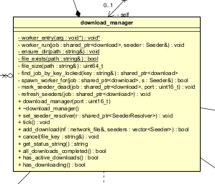
Completion
Notes:
When all chunks are done, the .part file is renamed to the final filename. The job state becomes Completed. WorkerExitGuard in worker_run() handles the final rename and marks the job completed. “At any time, the user can check download status. The manager prints progress, seeder ports, and state.” download_manager::get_status_string() builds the status line.

Slide 36
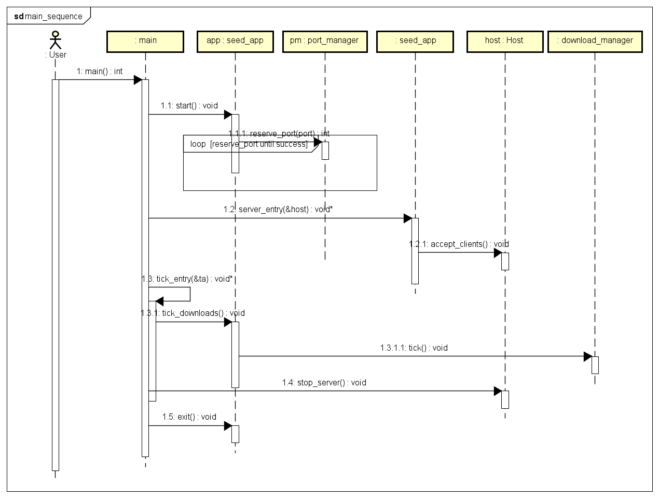
App starts → Port reserved → Host server runs → Files discovered → Seeders resolved → Download job created → Workers fetch chunks → Errors handled → File completed.
Notes:
When all chunks are done, the .part file is renamed to the final filename. The job state becomes Completed. WorkerExitGuard in worker_run() handles the final rename and marks the job completed. “At any time, the user can check download status. The manager prints progress, seeder ports, and state.” download_manager::get_status_string() builds the status line.

